Slide 1
HAIR SALON
Group Members :
Lim Xiu Qing
Tan Vin Nie
Vivian Tay Huey Shuen
Yeoh Sin Yuen
Ho Zi Yan
Wong Cho Mun
Yong Ai Yi

Slide 2
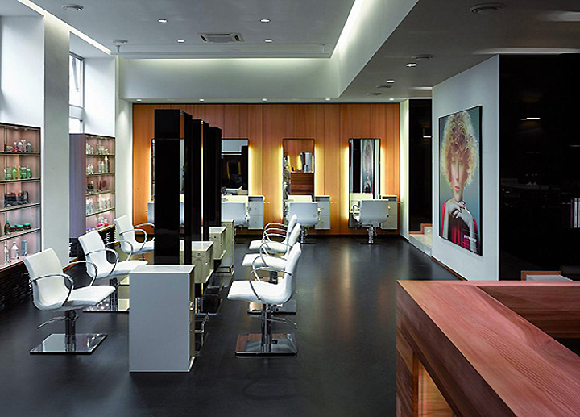
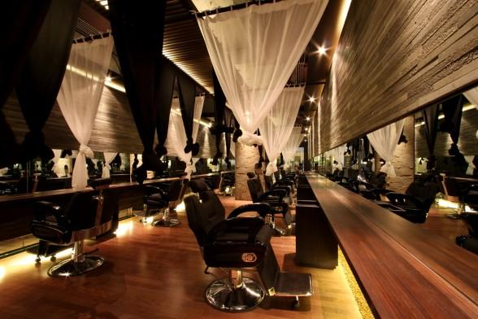
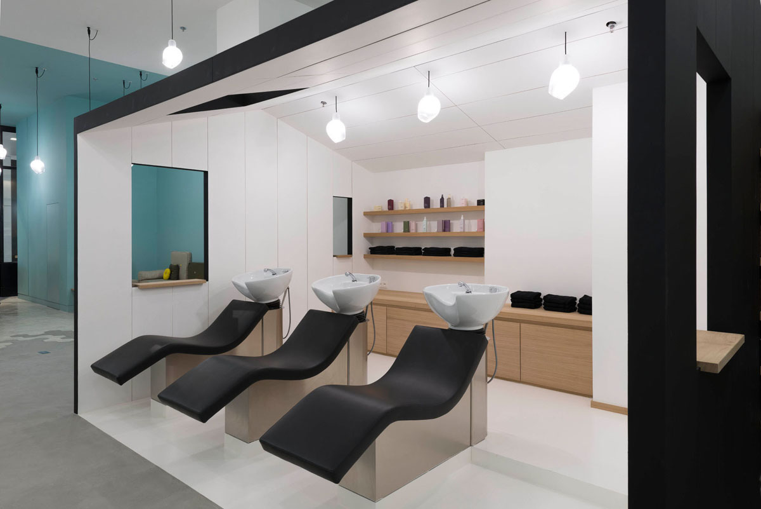
Hair Salon

Slide 3
History of Hair Salon

Slide 4
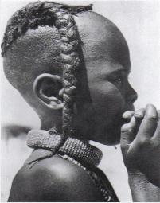
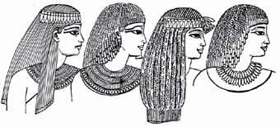
Ancient Egypt
In ancient Egypt, wealthy men and women would have shoulder-length hair or hair cut short to the nape or even clean shaven heads.
The women had hair styles that were usually cut short, or even in pigtails. It remained short because it was easy to maintain and to keep cool.

Slide 5
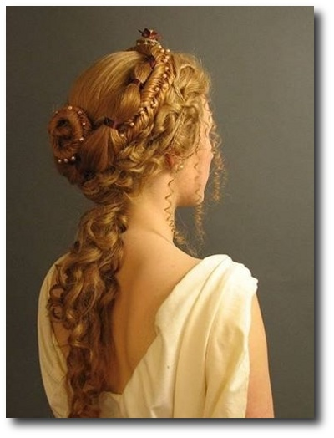
Ancient Greece
In ancient Greece and Rome, wealthy men had their servants as personal hairdressers, in addition to dyeing and shaving.

Slide 6
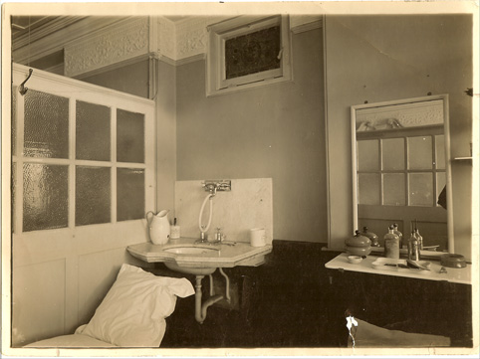
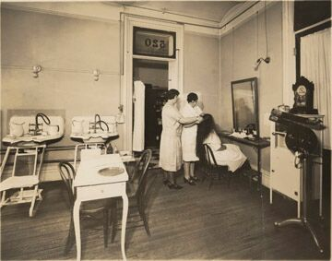
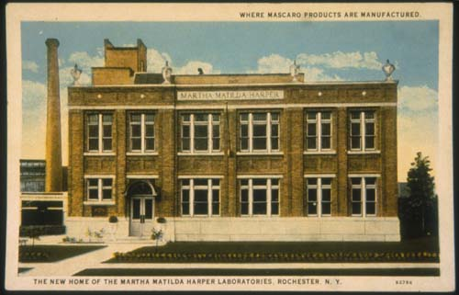
End of the 1800s
Martha Matilda Harper opened the first public salon called ‘The Harper Hair Parlor’
She started training schools and employed the girls in her salon.

Slide 7
From the 19th centuries to 20th centuries
Design for salon for Ecole Boulle, 1925, by Andre Frechet

Slide 8
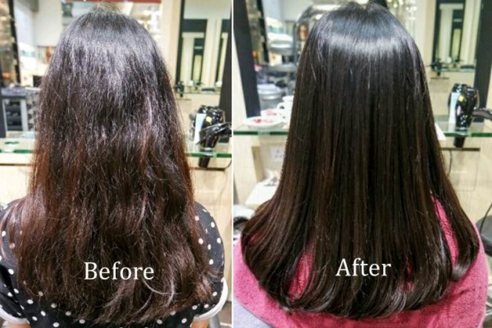
Malaysia
To gain high profits, the price of services such as colouring, bleaching and rebonding cost mostly hundred and thousand above.
Hairdressing industry in Malaysia increasingly popular.

Slide 9
Brief Description of the Businesses

Slide 10
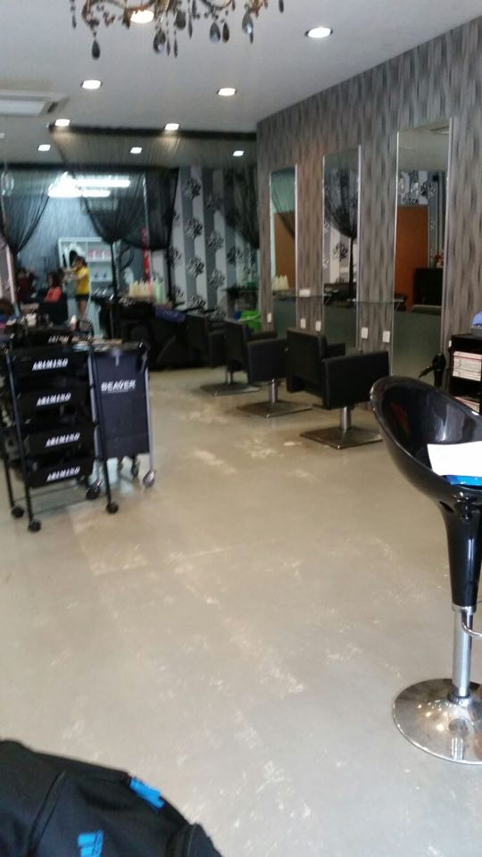
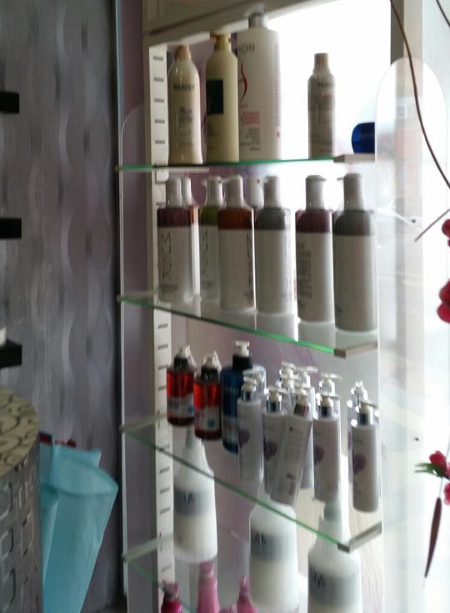
Swiss
Location: Klang, Selangor
Swiss’ owner: Kelly
Experience: Work as a hairdresser 8 years before having her own hair salon
Former Job: Apprentice
Passion: hairdressing
Salon Founded: 2010
No. Employees: 6
Strategies to retain the customer:
•Satisfied the needs of customers
•improve their skills of hairdressing
•They maintain a friendly, fair, and creative work environment
• Services that Swiss provides include haircuts, hair washing, and hair colouring and scalp treatment.
•Provides booking services due to the fact that they only have one stylist on duty.
•Develop good relationship with the customers
Customer’s age group: variety of ages
No. of customer per day: 20
Capital to start a salon: roughly one hundred thousand

Slide 11
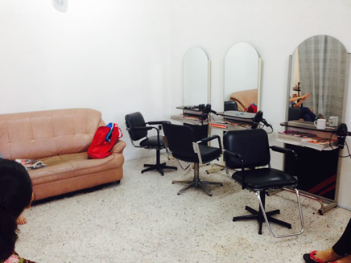
P&L
Location : Negeri Sembilan, home base salon (they change from shop lot to home base salon due to implementation of GST)
Salon Owner: James Lee and Apple Peng
Passion : Hairdressing
Founded year: 1994
Experience:
•James Lee work as a hairdressing at the age 18-20.
•1984, James went to Thailand and worked as a hair stylist.
•After he graduated from high school, he did not decide to further his studies. This was because he had found his passion in hairdressing.
•He then married with Apple Peng and decided to open their own Salon business.
Years to take to set up their salon: 25 years
No. of employees: none
Strategies to retain customers:
•Skills and techniques of hairdressing that suitable to customers.
•Travelled overseas to gain more knowledge about arts of
•Maintain a friendly and clean environment in their hair salon.
• P&L Salon provides lots of skilled services, such as haircuts, hair washing, hair colouring, hair rebonding and scalp treatment.

Slide 12
Comparative Analysis of the Businesses

Slide 13
Comparative Analysis of the Businesses
Summary Table
Swiss | Differences | P & L Hair Salon
2010 | Year of salon founded | 1994
Six workers, all of them are females | Workers | Two workers, who are the owners of this salon
One branches, which is just located behind the first-founded salon | Branches | None
Local customers, mostly from Klang White collars | Main Customers | Local customers, some are from Kuala Lumpur Families
Wide walkway and large waiting space for waiting customers | Space | Spaces are compact
Workers are individually given specific tasks such as hair cutting, hair blowing, hair coloring and etc. | Corporate Hierarchy | Workers are not given specific task, workers need to provide all services that customers need.

Slide 14
Large variety of haircare products. | Products Variety | Focus on few brands of haircare products.
Latest music | Music System | Radio music
Facilities are new, clean and are in good condition. | Facilities | Facilities are visually old.
High | Prices | Low
Establish additional branches | Future Plan | None
Shop Lot | Location | Home base salon

Slide 15
Conclusion of comparative analysis
Swiss is more successful than P&L because the design of the shop is more modern and fully with equipment.
Other than that, Swiss has more employees than P&L Salon.

Slide 16
Recommendations

Slide 17
Swiss (recommendation)
Renovate the salon.
entertain the waiting customers or other customers
more stylist on duty

Slide 18
P&L
advertise the salon
hire more people

Slide 19
REFERENCE
The Rise of Hair Salons Through the Ages. (2014, June 23). Retrieved from http://www.curioushistory.com/the-rise-of-hair-salons-through-the-ages
Hairstyling Tool. (n.d.). Retrieved February 28, 2009, from https://en.wikipedia.org/wiki/Hairstyling_tool
The Shaving Historical Timeline. (n.d.). Retrieved from http://haircuttingstories.net/Story/SingleStory/55b83e96e8f05328db60702d

Slide 20
CONCLUSION AND REFLECTION
IN THE PROCESS OF INTERVIEWING BOTH SALON OWNER’S, WE LEARNT THAT EVERY BUSINESS HAS THEIR OWN CHALLENGES AND THEIR STRATEGIES OF SOLVING THE ISSUES. IT IS A BLEESING TO HAVE THIS EXPERIENCE OF INTERVIEWING TWO HAIR SALON AND LEARN FROM THEM. I HEREBY TAKE THIS OPPORTUNITY TO THANK THE LECTURER FOR GIVING US A CHANCE TO LEARN HOW A SUCESSFUL BUSINESS WORK.

Slide 21
THE END Thank You

