Slide 1
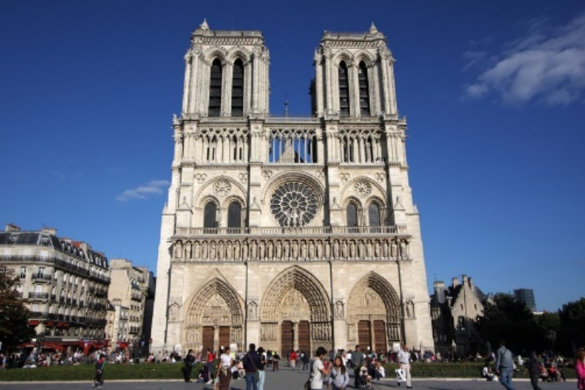
NOTRE DAME DE PARIS
RELIGIOUS BUILDING FROM PARIS, FRANCE

Slide 2
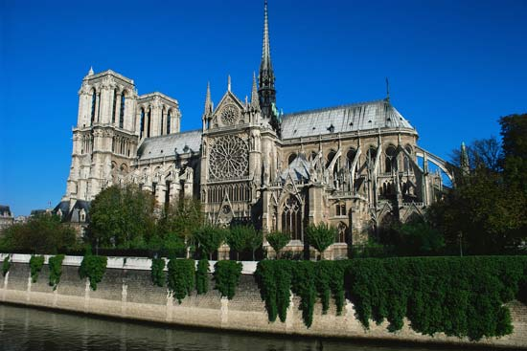
Historical Background
Notre Dame de Paris or Notre Dame Cathedral is a Catholic treasure which is over 800 years old.
It is located on a small island called the Ile de la Cite in the middle of river Seine.
The building of the cathedral was completed over the course of 200 years
It was started in 1163 during the reign of King Louis VII and was completed in 1345.

Slide 3
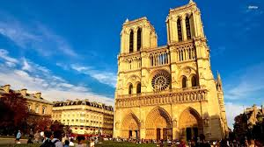
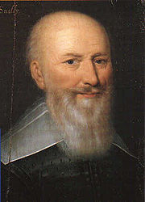
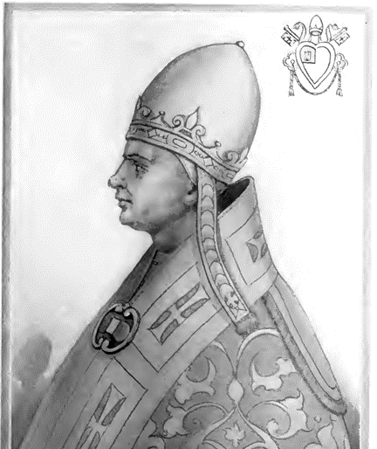
Construction of Notre Dame Cathedral began in 1163 after Pope Alexander III laid the cornerstone for the new cathedral.
By the time of Bishop Maurice de Sully's death in 1196, the apse, choir and the new High Altar were all finished, while the nave itself was nearing completion.
In 1200, work began on the western facade, including the west rose window and the towers, all of which were completed around 1250, along with a new north rose window.
Bishop Maurice de Sully
Pope Alexander III

Slide 4
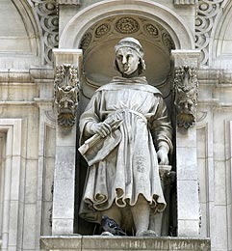
Historical Background
Also during the 1250s, the transepts were remodelled in the latest style of Rayonnant Gothic architecture by architects Jean de Chelles and Pierre de Montreuil, and the clerestory windows were enlarged.
The last remaining elements were gradually completed during the following century. (1345)
Jean de Chelles
Pierre de Montreuil

Slide 5
STRUCTURE & LAYOUT
OF NOTRE DAME

Slide 6
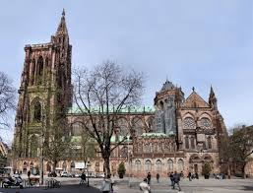
FRONT VIEW
SOUTH VIEW

Slide 7
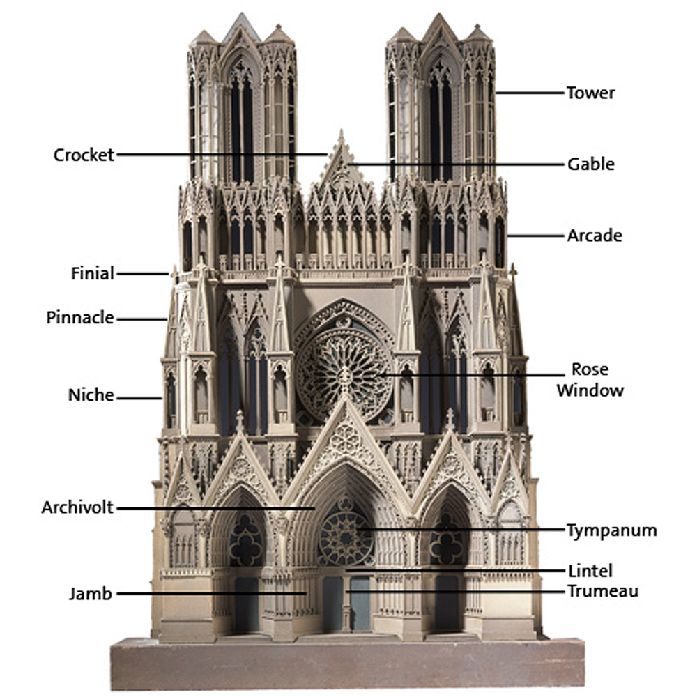
Notre-Dame measures 130 metres long, 48 metres wide, 35 metres high and can hold more than 6000 people.

Slide 8
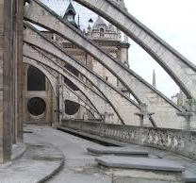
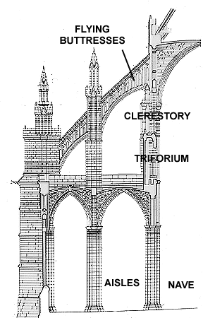
Flying Buttresses
Strongly associated with gothic church architecture.
Structure typically consisting of an inclined bar carried on a half arch that extends from the upper part of a wall to a pier some distance away and carries the thrust of a roof or vault.
The purpose is to resist the lateral forces pushing a wall outwards by redirecting them to the ground.

Slide 9
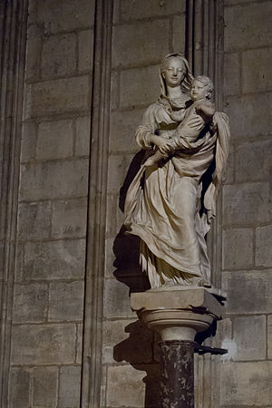
STRUCTURE OF NOTRE DAME
STATUE OF VIRGIN AND CHILD
A marble statue created in the early 14th century.
Stands in the Cathedral of Notre Dame in Paris.
example of the court style in Late Gothic sculpture.
It was nicknamed the Virgin of Paris because it stands in Paris, France.
Sometimes being called one of the most decorative statues in all of Catholicism.
It is in honour of the Blessed Virgin, mother of Jesus. It retains an emotional appeal that links it to the Strasbourg Death of the Virgin.

Slide 10
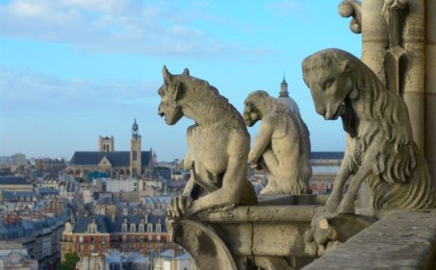
STRUCTURE OF NOTRE DAME
GARGOYLE
Carved on stone grotesque with a spout designed to convey water from a roof and away from the side of the building thereby preventing rainwater from running down masonry walls and eroding them.
Typically, rainwater exits through the open mouth of the gargoyle. (minimize damage)
Usually fantastic animal like a dragon or any legendary creature are mounted on the town’s cathedral to display God’s love to all creatures

Slide 11
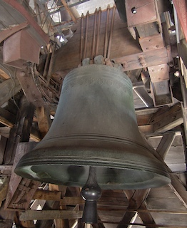
STRUCTURE OF NOTRE DAME
Emmanuel Bell
Notre-Dame’s largest bell, located in South tower
It is sounded for major holidays like Christmas, Easter, Whitsunday, or All Saint’s Day, or for important events
The Emmanuel Bell was cast over three hundred years ago and was named by its godfather Louis XIV.
It weighs 13 tons, and its tongue, the inner part of the bell that strikes its walls to make sounds, weighs 500 kilos.
The North Tower is home to four bells rung daily to indicate the cathedral’s services and the time. They each weigh between 2,000 and 3,000 kilograms.

Slide 12
LAYOUT OF NOTRE DAME

Slide 13
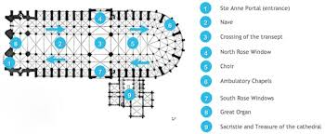
LAYOUT OF NOTRE DAME
ST. Anne Portal
Nave
Crossing of transept
North Rose Window
Choir
Ambulatory chapel
South Rose Windows
Great Organ
Sacristle and treasure of cathedral

Slide 14
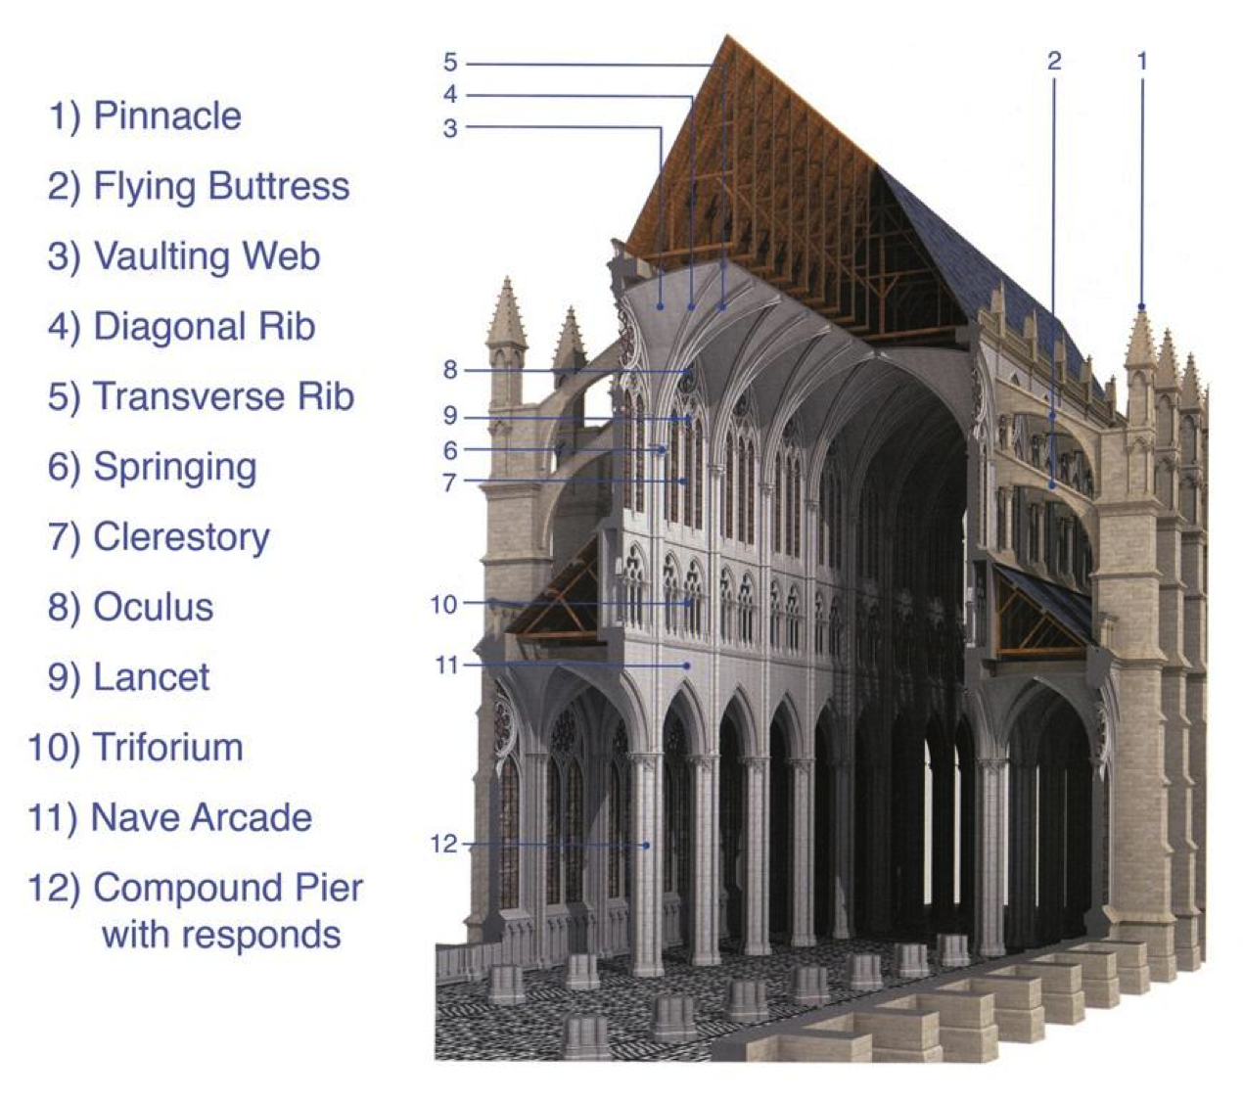
CROSS- SECTIONAL LAYOUT

Slide 15
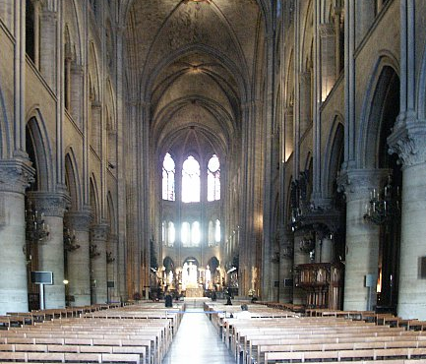
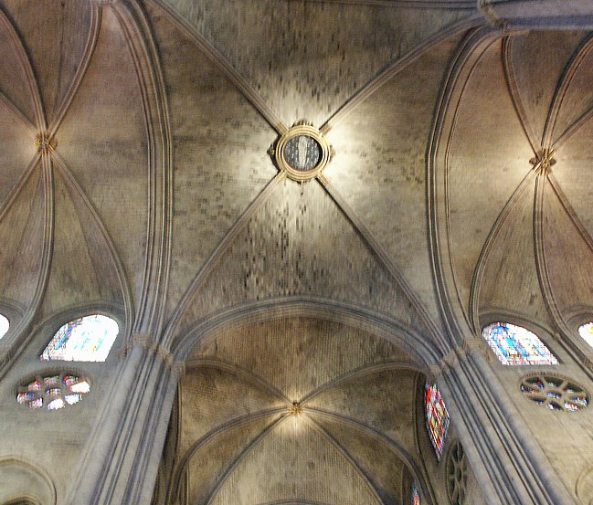
INTERIOR STRUCTURE OF NOTRE DAME
CHURCH
TOP CEILING

Slide 16
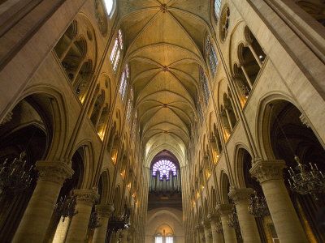
ORNAMENTS OF NOTRE DAME

Slide 17
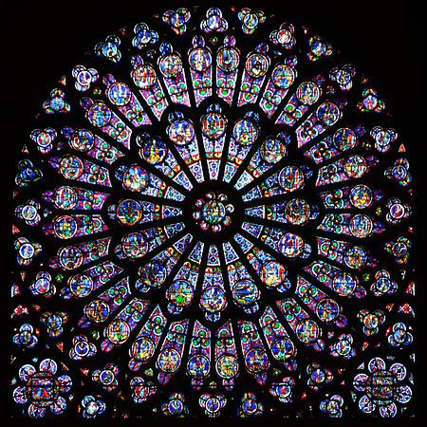
ORNAMENTS OF NOTRE DAME
The west rose window at Notre Dame is 10 meters in diameter and exceptionally beautiful.
Dating from about 1220, it retains most of its original glass and tracery.
The main theme of the west rose is human life, featuring symbolic scenes such as the Zodiacs and Labours of the Months.
On the exterior, it is fronted by a statue of the Virgin and Child accompanied by angels.
Unfortunately, the interior view of its colourful medieval glass is now more than half blocked by the great organ.
West Rose Window

Slide 18
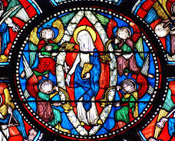
ORNAMENTS OF NOTRE DAME
Stained Glass Windows
The stained glass windows of the Notre-Dame are very beautiful and a significant number of them date from the 13th century when the cathedral was constructed.
Beautiful collection of 13th-century Gothic art
The highlight is the set of three beautiful rose windows

Slide 19
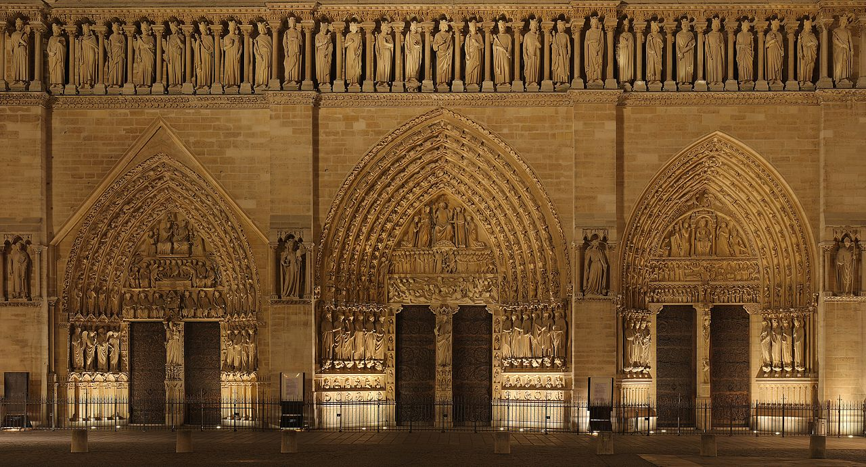
ORNAMENTS OF NOTRE DAME
Tympana
There are three tympana on the main façade here.
Tympana is a semi-circular or triangular decorative wall surface over an entrance, bounded by a lintel and arch.
It often contains sculpture or other imagery or ornaments.
Bands of molding surrounding the tympanum are referred to as the archivolt.
In French architecture, the tympanum is often supported by a decorated pillar called a trumeau.
ARCHIVOLT
TYMPANUM

Slide 20
MATERIAL USED BY NOTRE DAME

Slide 21
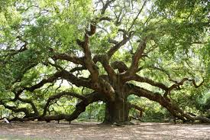
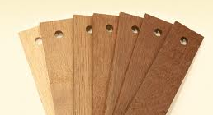
MATERIAL USED BY NOTRE DAME
OAK
This building has been given the romantic name of “the forest” because of the many of the beams used to build it, each beam came from a different tree.
The structure is made from oak. Its dimensions are very impressive: 120 m long, 13 m wide at the nave, 40 m in the transept and 10 m high.

Slide 22
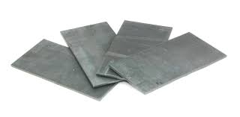
MATERIAL USED BY NOTRE DAME
LEAD PLATES
The roof was made using 1,320 lead plates weighing over 210,000 kilograms

Slide 23
MATERIAL USED BY NOTRE DAME
STONE
Statues like the Virgin and Child (Virgin de Paris) and Gargoyles are made from stone.

Slide 24
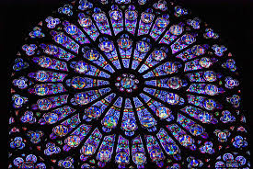
MATERIAL USED BY NOTRE DAME
Glass
There are stained glass windows in Notre Dame, located at the North and South tower.

Slide 25
REFERENCE
Flying buttress | architecture. (n.d.). Retrieved January 20, 2016, from http://global.britannica.com/technology/flying-buttress
Flying buttress | architecture. (n.d.). Retrieved January 20, 2016, from http://global.britannica.com/technology/flying-buttress
Notre-Dame Cathedral, Paris (1163-1345). (n.d.). Retrieved January 20, 2016, from http://www.visual-arts-cork.com/architecture/notre-dame-paris.htm
Gothic cathedral and church construction. (n.d.). Retrieved January 20, 2016, from http://www.abelard.org/france/cathedral-construction.php#stone

Slide 26
THANK YOU

