Slide 1
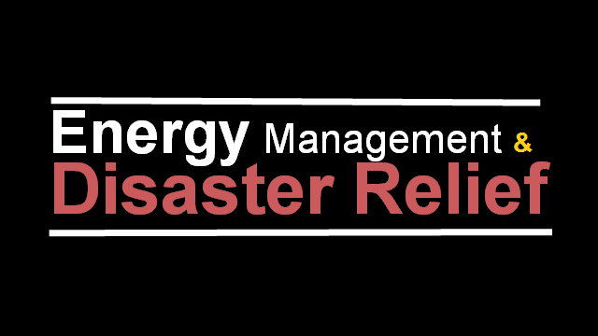

Slide 2
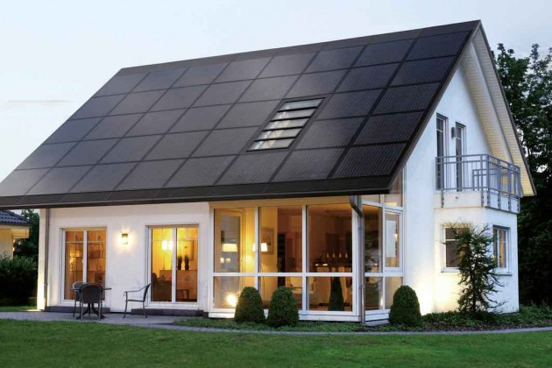
Energy Management
Install solar panels in all the buildings in the city
It’s the energy of the future
It’s renewable and environmentally friendly
An investment for the future
Save the environment & cost.

Slide 3
Tsunami
Methods of disaster relief
Digging deeper into the bedrocks by the coasts.
Build skyscrapers using hard and strong materials.

Slide 4
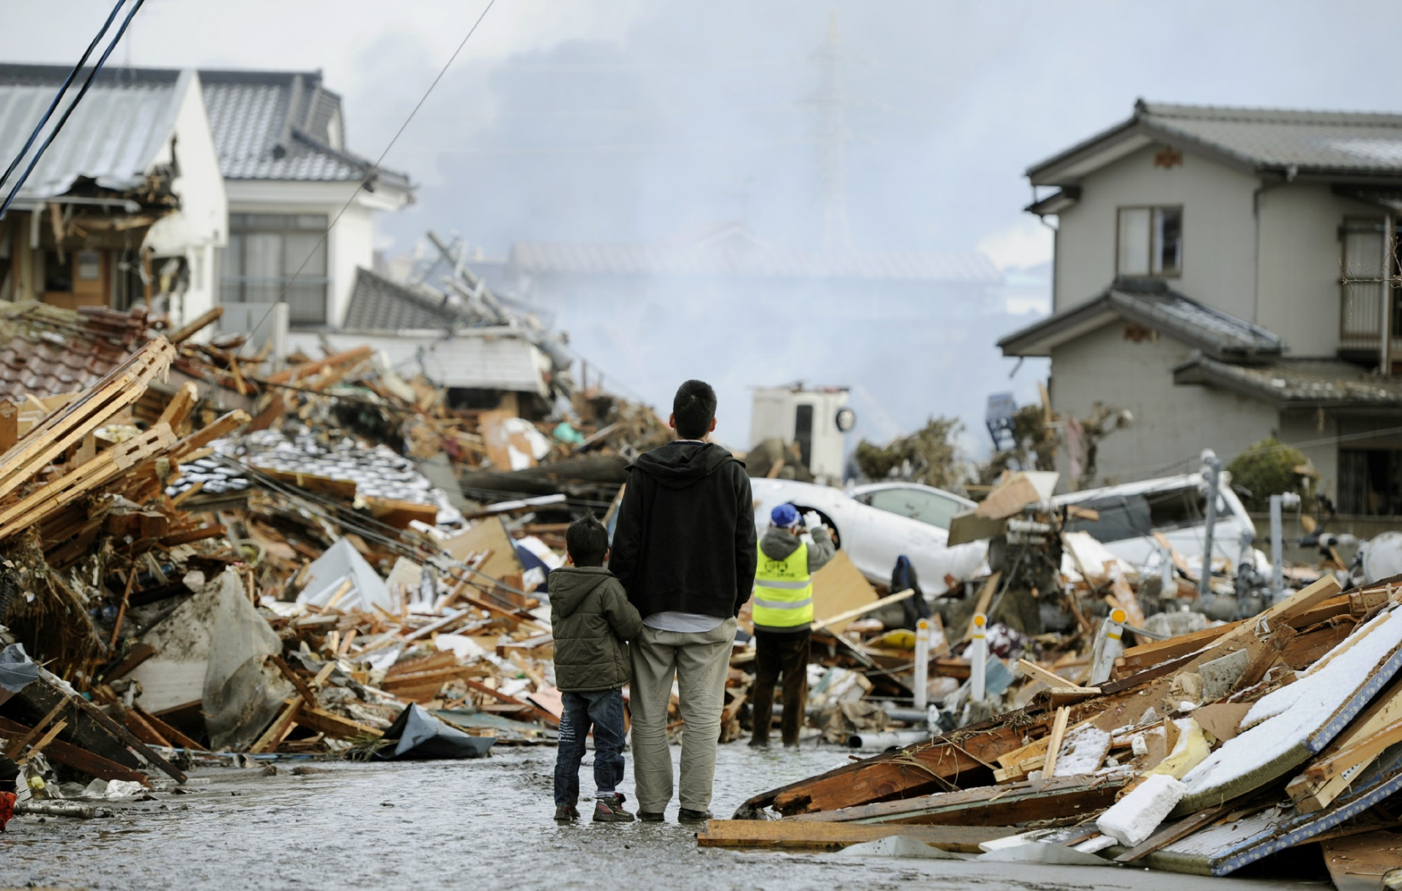
Disaster Relief
The process of responding to a catastrophic situation, providing aid to people and communities who have suffered from some form of disaster.

Slide 5
Earthquakes
Driving pillars into the ground, then connecting them together to build a foundation for the whole city.
Use ball bearings as a base for the city.

