Slide 1
Cones and Frustum

Slide 2
What is a Cone?
A solid or hollow object that tapers from a circular or roughly circular base to a point.

Slide 3
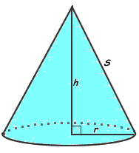
Types of Cones
Right Cone - A cone that has its apex aligned directly above the center of its base.
Oblique Cone – A cone that has its apex not aligned above the center of its base
http://www.mathopenref.com/common/appletframe.html?applet=coneoblique&wid=600&ht=350
Right Cone
Oblique Cone

Slide 4
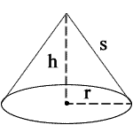
Volume of Cone
Formula:
Volume $=πr^{2}h$
r = radius of circular base
h = height of the cone
Can be used for both right and oblique cone.

Slide 5
Total Surface Area
Formula:
$TSA=πrs$ + $πr^{2}$
$=πr(s+r)$
r = radius of circular base
s = slant height of the cone
This formula CANNOT be used for oblique cone. (There are NO formula to find TSA of oblique cone)

Slide 6
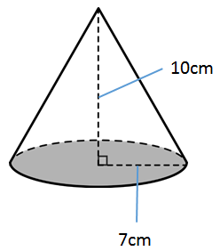
Example 1
Find out the Volume and the Total Surface Area of the cone.
< Given: $π= \frac{22}{7}$ >
Volume $=\frac{1}{3}πr^{2}h$
$=\frac{1}{3}$ $×\frac{22}{7}×7^{2}×$10
$=513.333{cm}^{3}$

Slide 7
Total Surface Area
$$=πr\left(s+r\right)$$
$$=\frac{22}{7}×7(\sqrt{149}+7)$$
$$=22\left(\sqrt{149}+7\right)$$
$$=422.544{cm}^{2}$$
$$s=\sqrt{{10}^{2}+7^{2}}$$
$=\sqrt{149}$

Slide 8
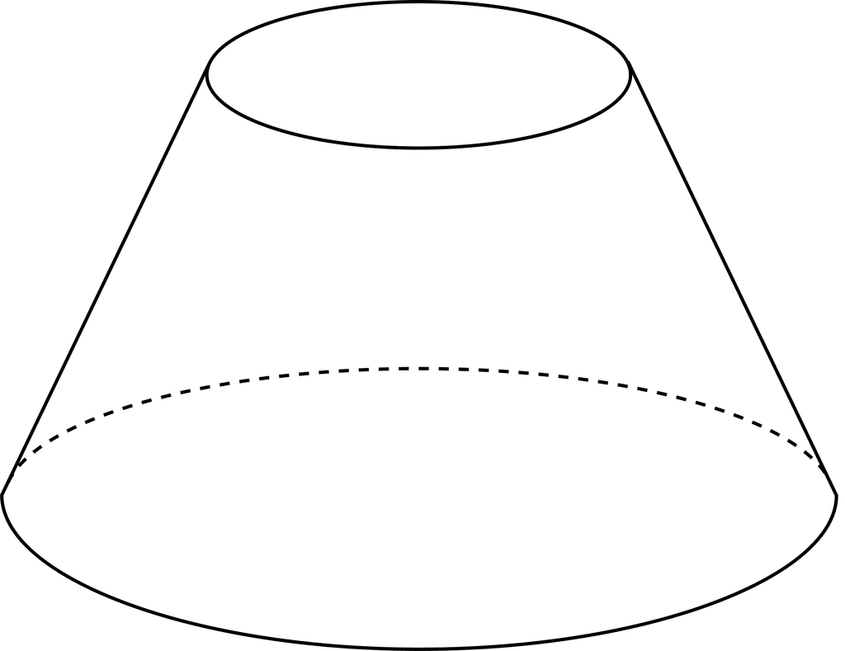
What is a Conical Frustum?
A conical frustum is a frustum created by slicing the top off a cone (with the cut made parallel to the base).

Slide 9
Volume of Conical Frustum
METHOD 1
Formula:
V $=\frac{πh}{3}{(R^{2}+Rr+r}^{2}$)
h = height of the frustum
r = radius of the circular top of the frustum
R = radius of the circular base of the frustum

Slide 10
Total Surface Area of Conical Frustum
Formula:
Lateral Surface Area:
TSA $=πs (R+r)$
Circular Surface Area:
(Top) CSA = $πr^{2}$
(Bottom) CSA = $πR^{2}$
Total Surface Area:
TSA = $πs \left(R+r\right)+{πr}^{2}$ + $πR^{2}$
$= π\sqrt{{(R −r)}^{2} +{ h}^{2}}\left(R+r\right)+{πr}^{2}$ + $πR^{2}$
$$s= \sqrt{{(R −r)}^{2} +{ h}^{2}}$$

Slide 11
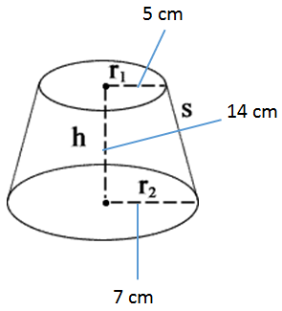
Example 2
Find out the Volume and the Total Surface Area of the frustum.
< Given: $π=\frac{22}{7}$ >
Volume $=\frac{πh}{3}(R^{2}+Rr+r^{2})$
$=\frac{\frac{22}{7}×14}{3}(7^{2}+35+5^{2})$
$=\frac{44}{3}×109$
$=1598.667{cm}^{3}$

Slide 12
Total Surface Area
$$=πs\left(R+r\right)+πR^{2}+πr^{2}$$
$$=\frac{22}{7}×10\sqrt{2}\left(7+5\right)+\frac{22}{7}×$$
$7^{2}+\frac{22}{7}×5^{2}$
$$=533.361+154+78.571$$
$$=765.932{cm}^{2}$$
S $=\sqrt{{(7−5)}^{2}+{14}^{2} }$
$=10\sqrt{2}$

Slide 13
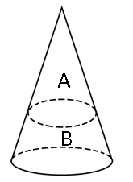
Example 3
Diagram shows cone A and frustum B. Ratio of slant height cone A to slant height frustum B is 1:2 . Given that radius of cone A is 4cm and its volume is 16$π{cm}^{3}$. Find out the volume and the total surface area of frustum B in terms of $π$.

Slide 14
Height of cone A:
Volume $=\frac{1}{3}πr^{2}h$
$$16{πcm}^{3}=\frac{1}{3}×π×4^{2}×h$$
$16{cm}^{3}=\frac{16}{3}h$
$$h=16×\frac{3}{16}$$
$$h=3cm$$
Slant height of cone:
$$ℓ=\sqrt{r^{2}+h^{2}}$$
$=\sqrt{4^{2}+3^{2}}$
$=\sqrt{25}$
$=5cm$

Slide 15
Ratio of slant height cone A to slant height frustum B

Slide 16
Solution 1:
Volume of frustum B
$$=\frac{1}{3}πR^{2}H − \frac{1}{3}πr^{2}h$$
$$=\frac{1}{3}π×{12}^{2}×9−\frac{1}{3}π×4^{2}×3$$
$$=432π−16π$$
$$=416π{cm}^{3}$$
Solution 2:
Volume of frustum B
$$=\frac{π\left(H−h\right)}{3}(R^{2}+Rr+r^{2})$$
$$=\frac{π\left(9−3\right)}{3}\left({12}^{2}+48+4^{2}\right)$$
$$=2π×208$$
$$=416π{cm}^{3}$$

Slide 17
Total Surface Area of frustum B
$= π\sqrt{{(R −r)}^{2} +{ (H−h)}^{2}}\left(R+r\right)+{πr}^{2}$ + $πR^{2}$
$$=π\sqrt{{\left(12−4\right)}^{2} + {\left(9−3\right)}^{2}}\left(12+4\right)+$$
$π{(4)}^{2} + π{(12)}^{2}$
$$=π10\left(16\right)+16π+144π$$
$$=160π+160π$$
$=320π{cm}^{2}$

